Slide 1
Coexistence and Adaptations: Juvenile Pink and Chum Salmon Feeding Behaviour in B.C.
Vanessa Fladmark
MSc Thesis Project
PEL Meeting
March 30th, 2020

Slide 2
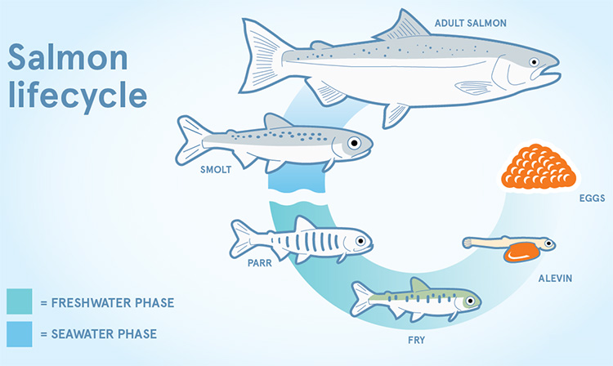
Spatial Chapter – Introduction
Salmon early migration
Pink salmon foraging
Chum salmon foraging

Slide 3
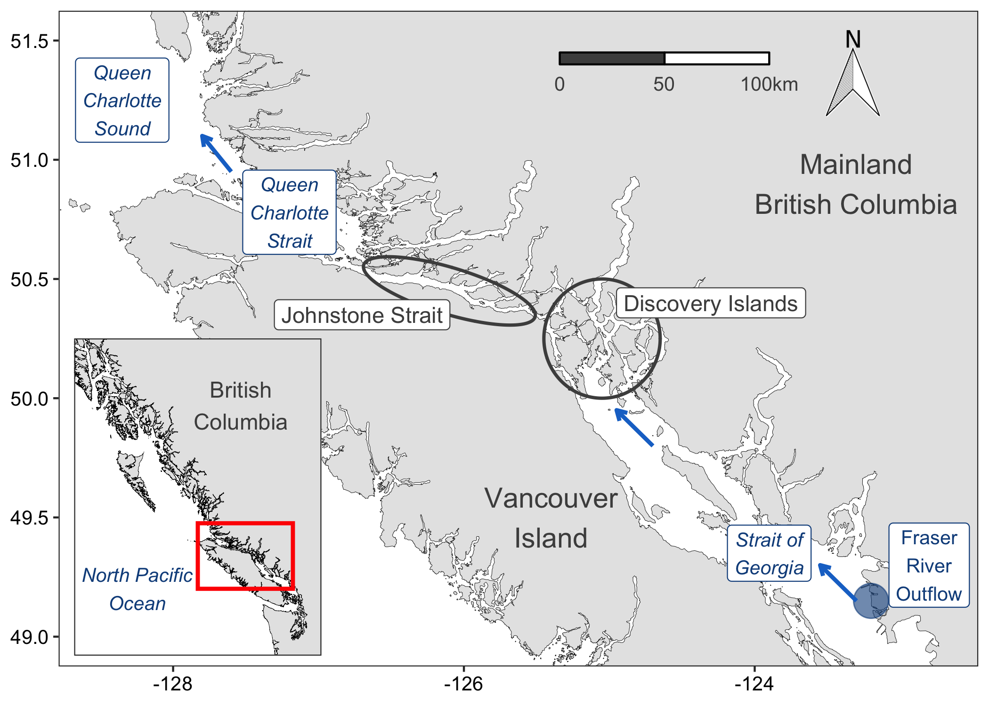
Spatial Chapter – Introduction
Discovery Islands: Complex archipelago
Johnstone Strait: “Trophic gauntlet”
Queen Charlotte Strait: Feeding refuge
Salmon coastal foraging

Slide 4
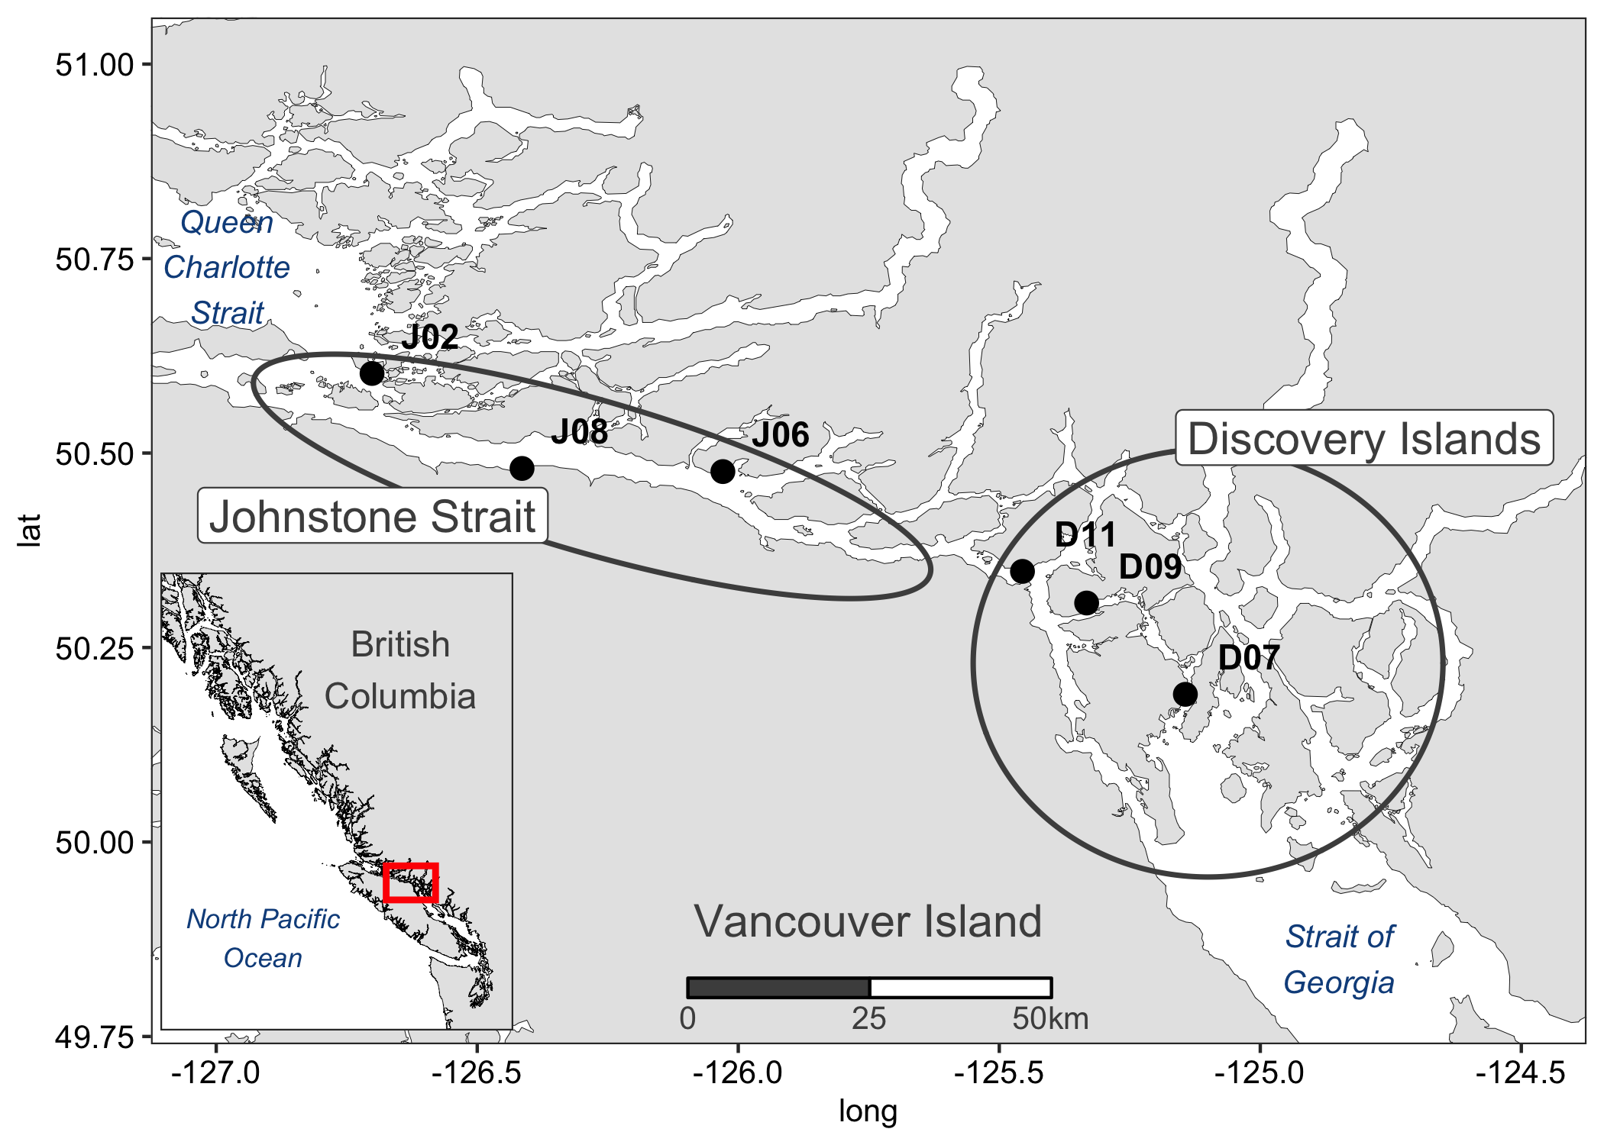
Chapter 1 – A difficult route (Spatial data)
Spatial – Methods: June 8-16th, 2016
ethods (sampling design comes first? Maybe even in prev. slide
n = 60
n = 60

Slide 5
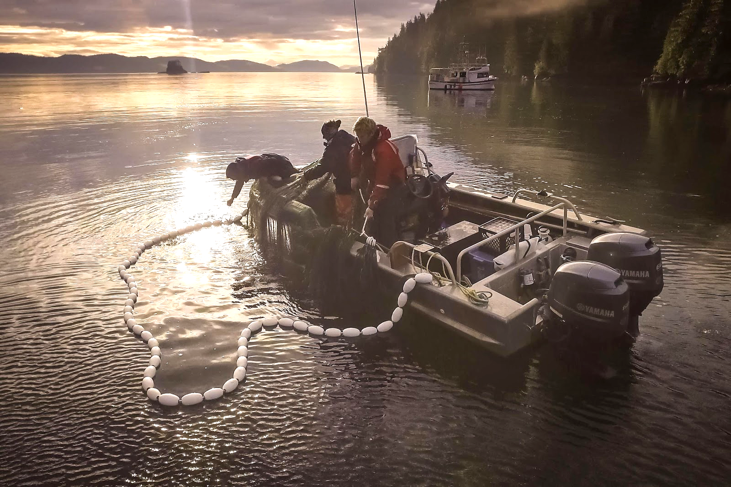
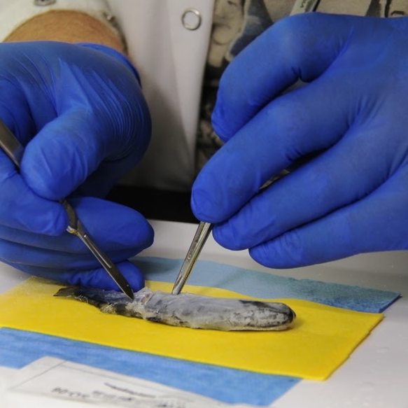
Spatial Chapter – Methods
Juvenile salmon program field sampling

Slide 6
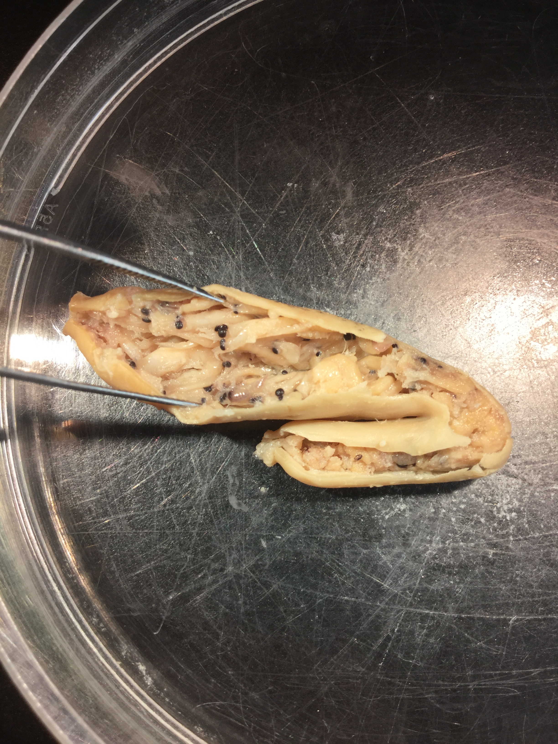
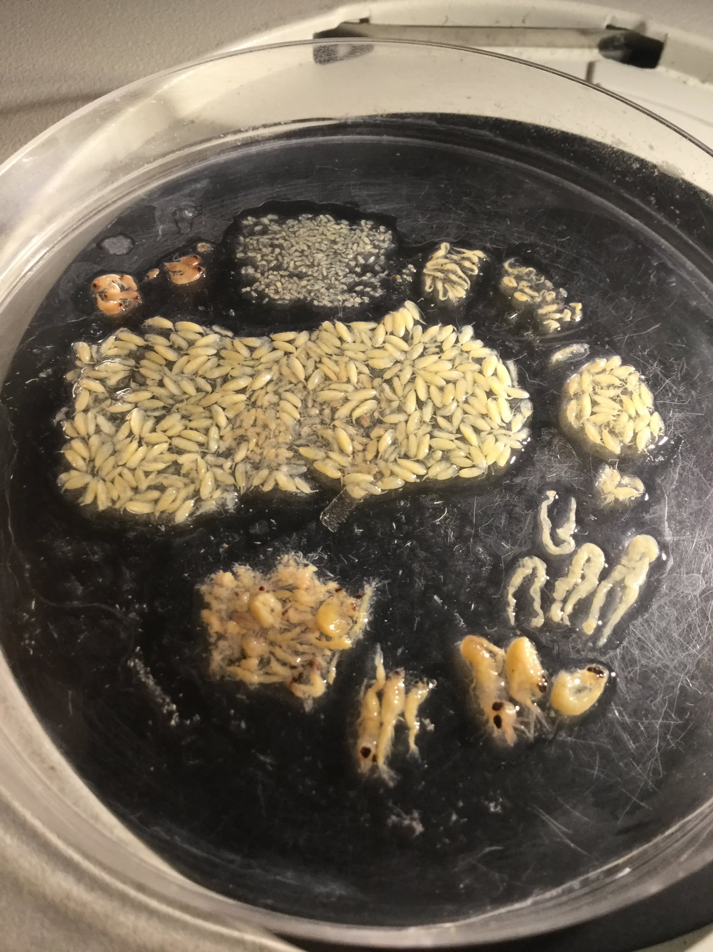
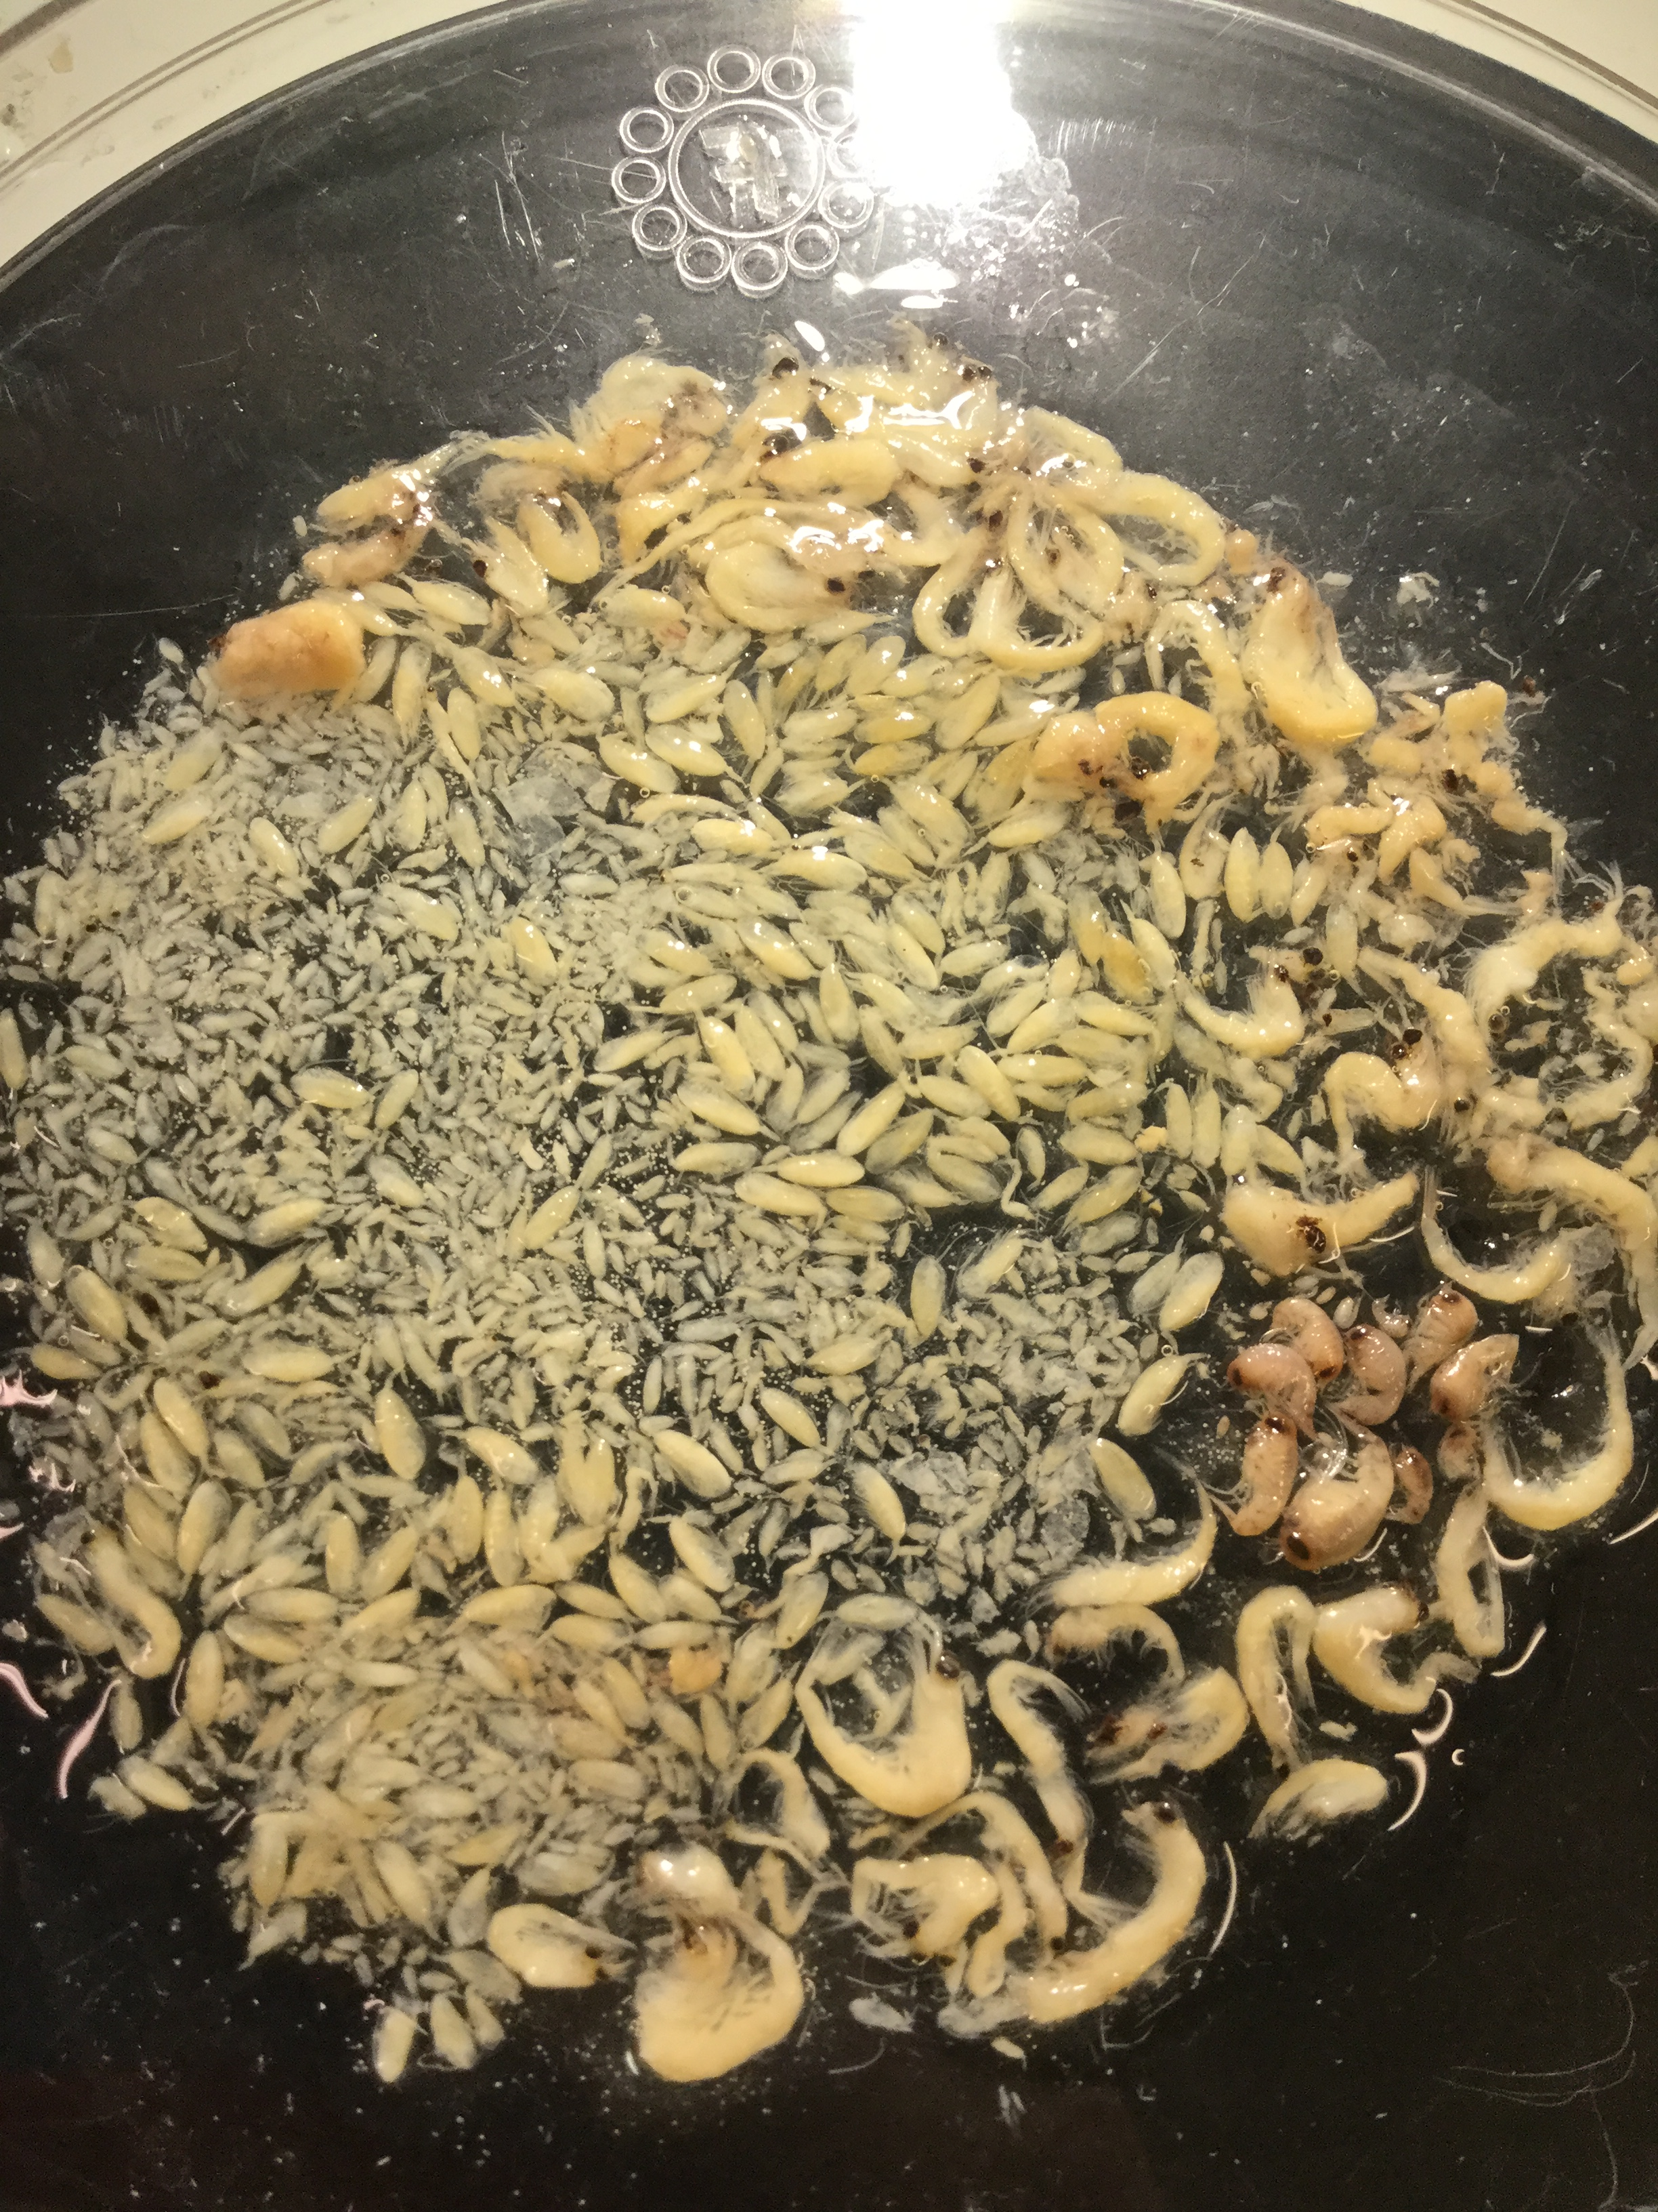
Spatial Chapter – Methods
Stomach content analysis (looking inside tummies!)

Slide 7
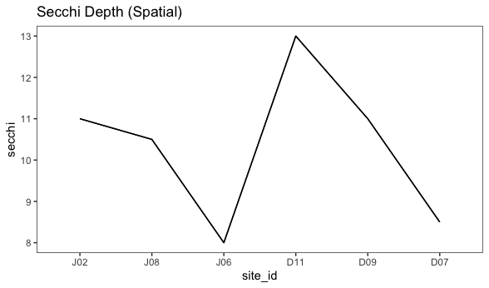
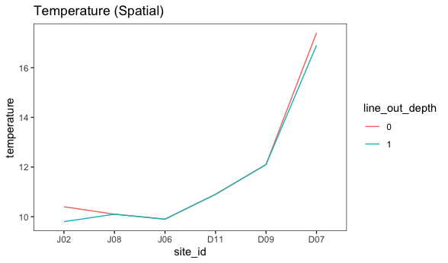
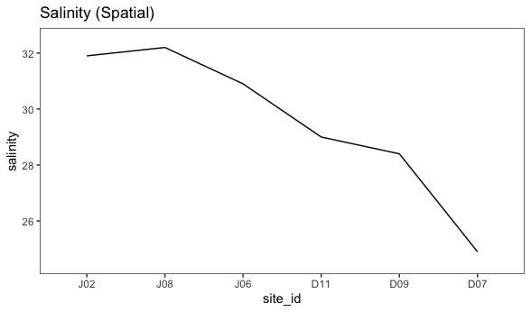
Spatial Chapter – Results
Environmental data (paired w/fish)

Slide 8
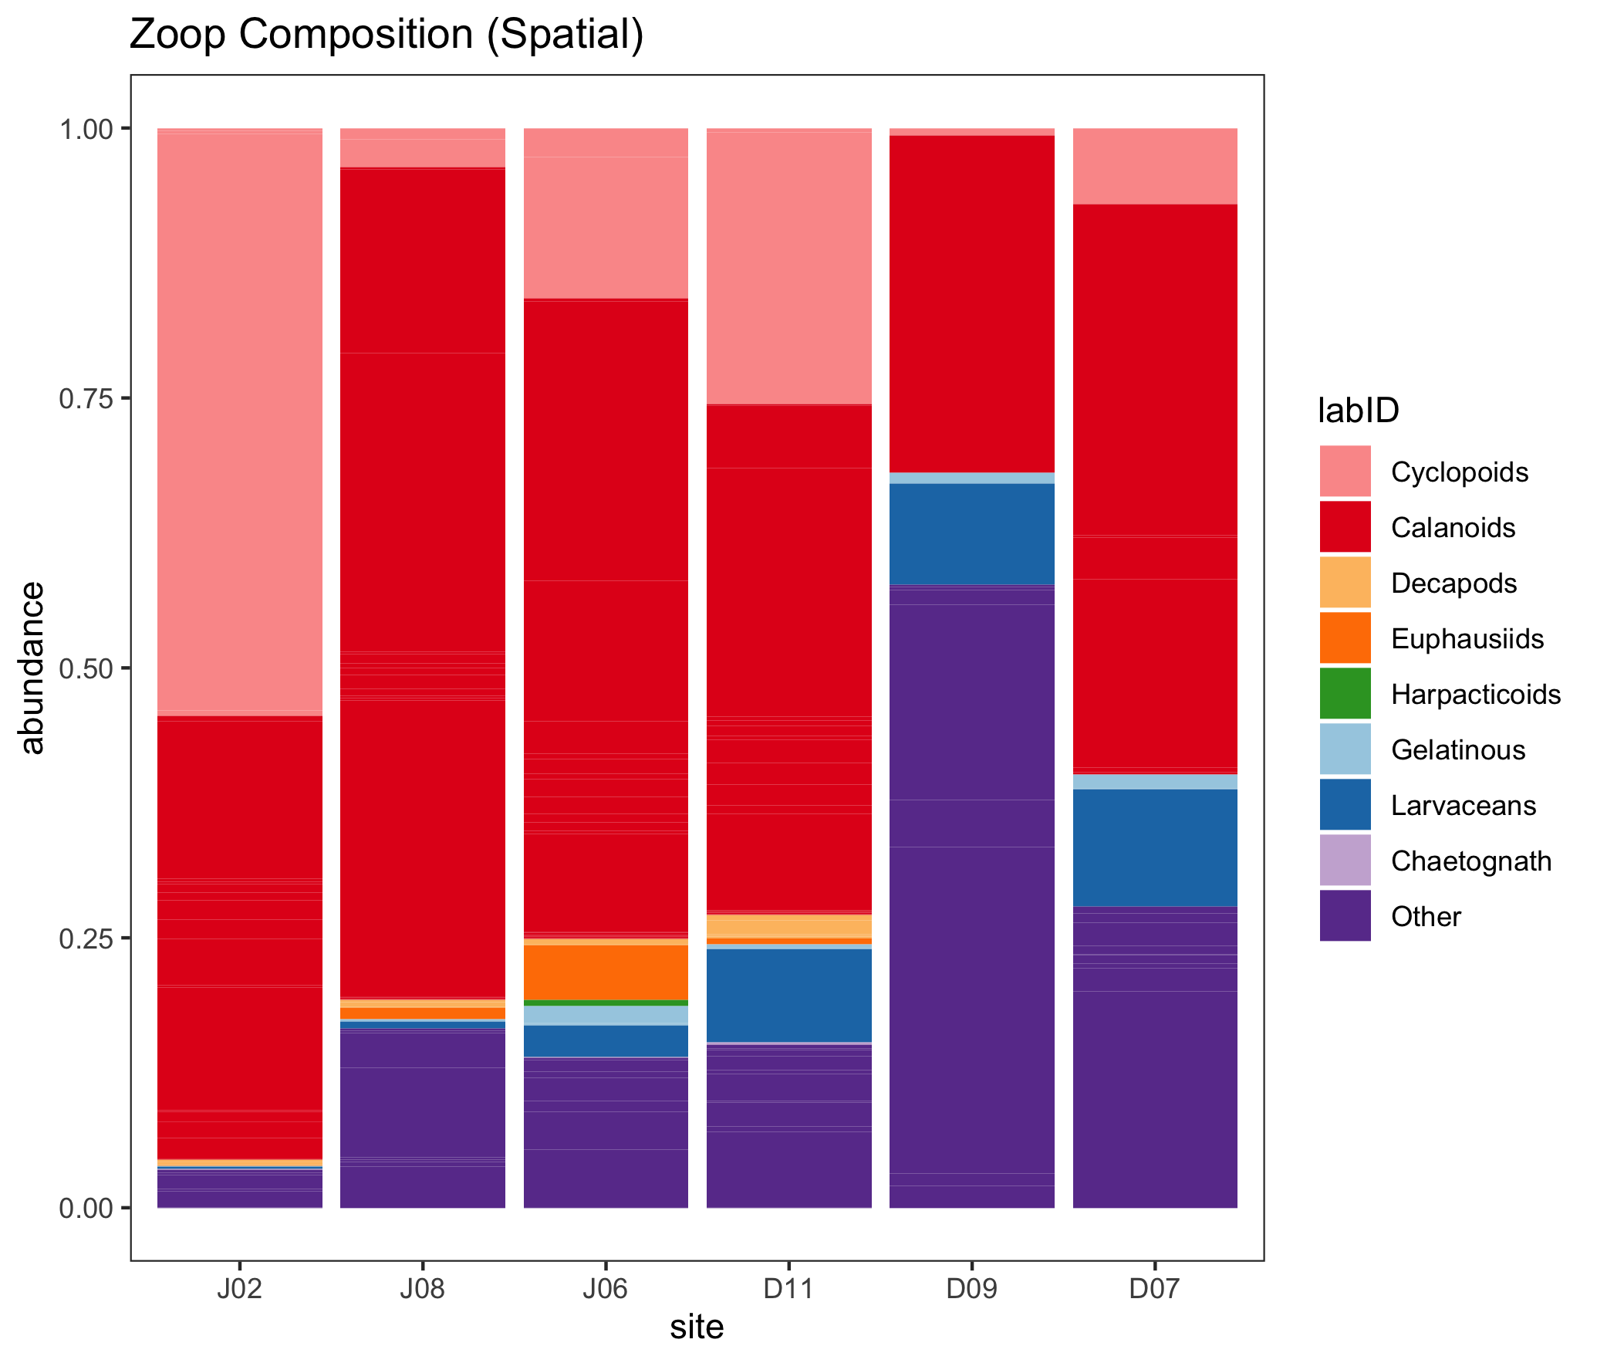
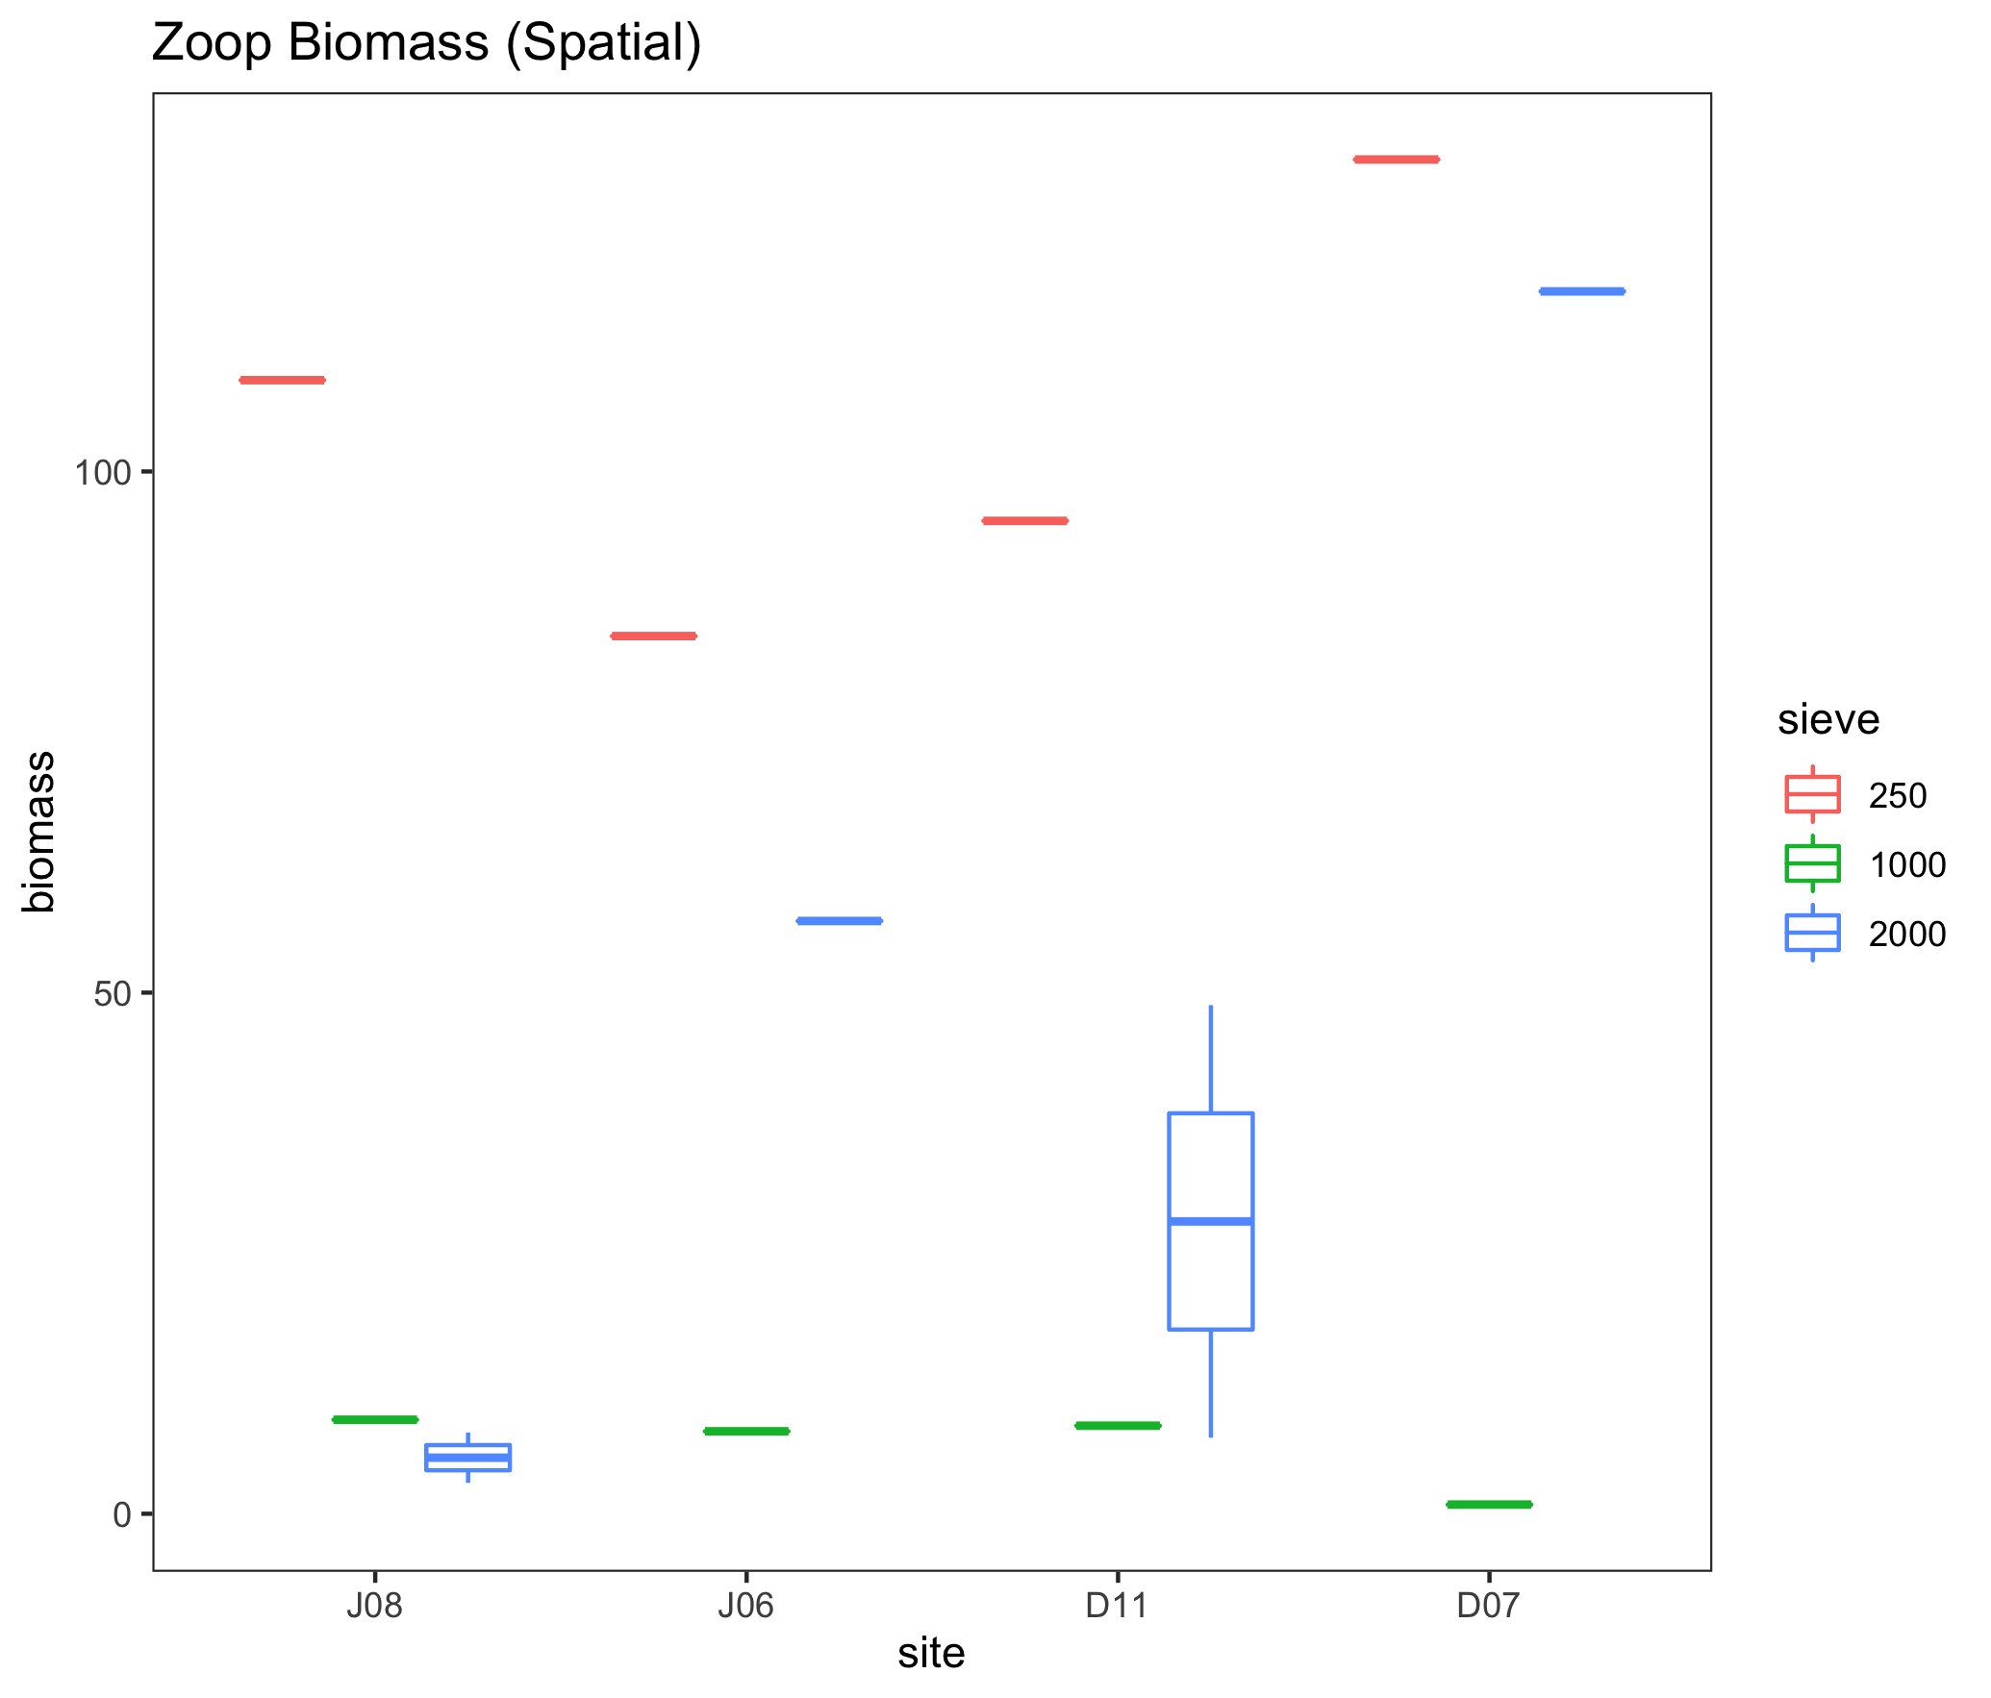
Spatial Chapter – Results
Zooplankton (paired w/fish)

Slide 9
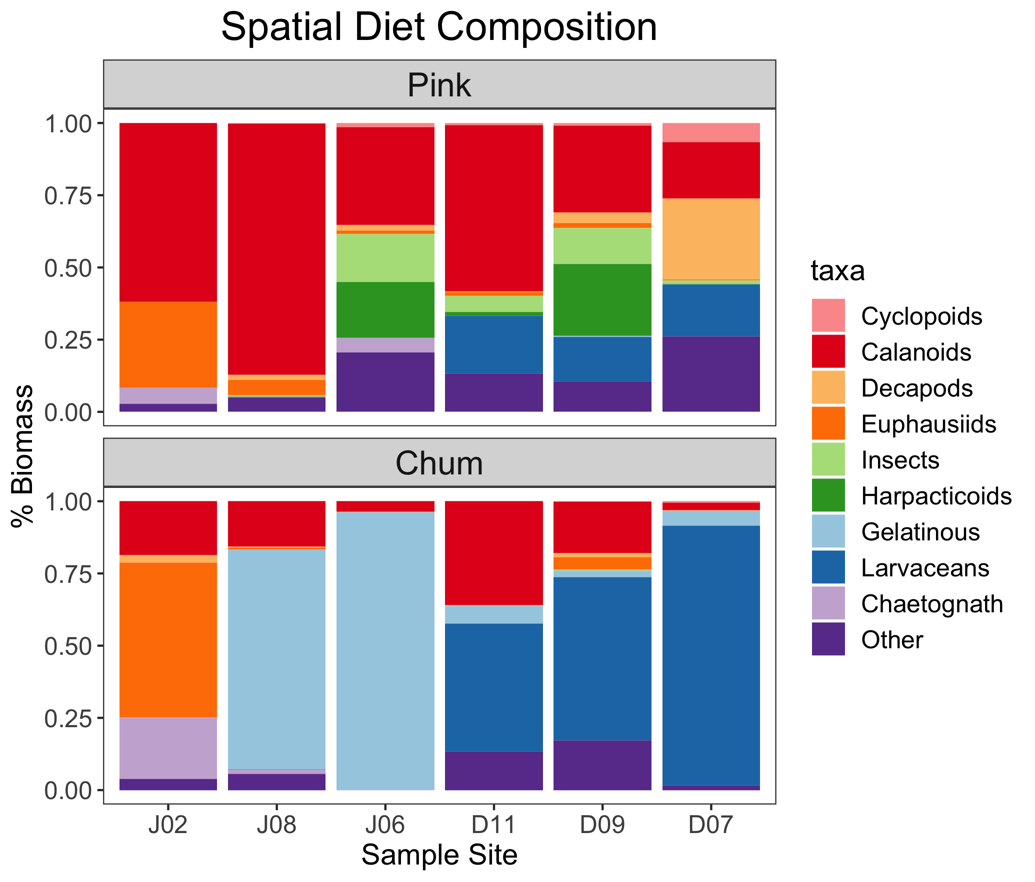

Slide 10
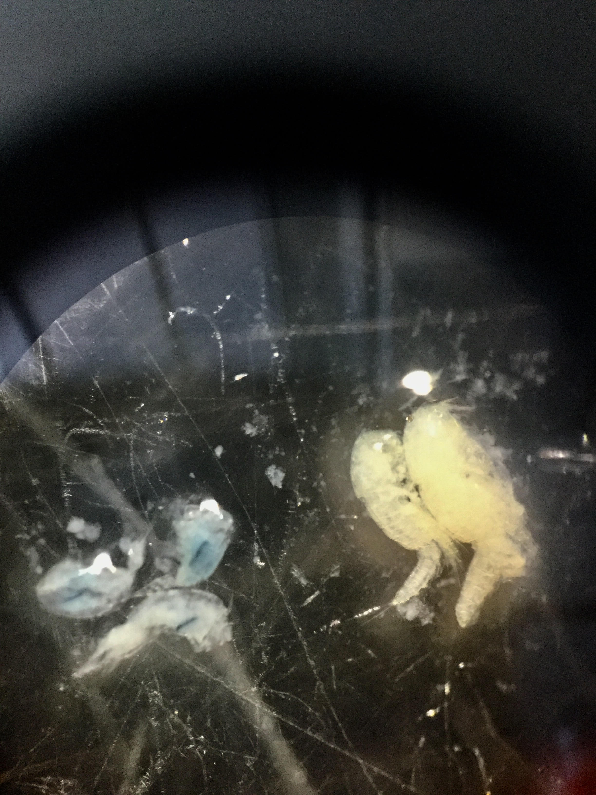
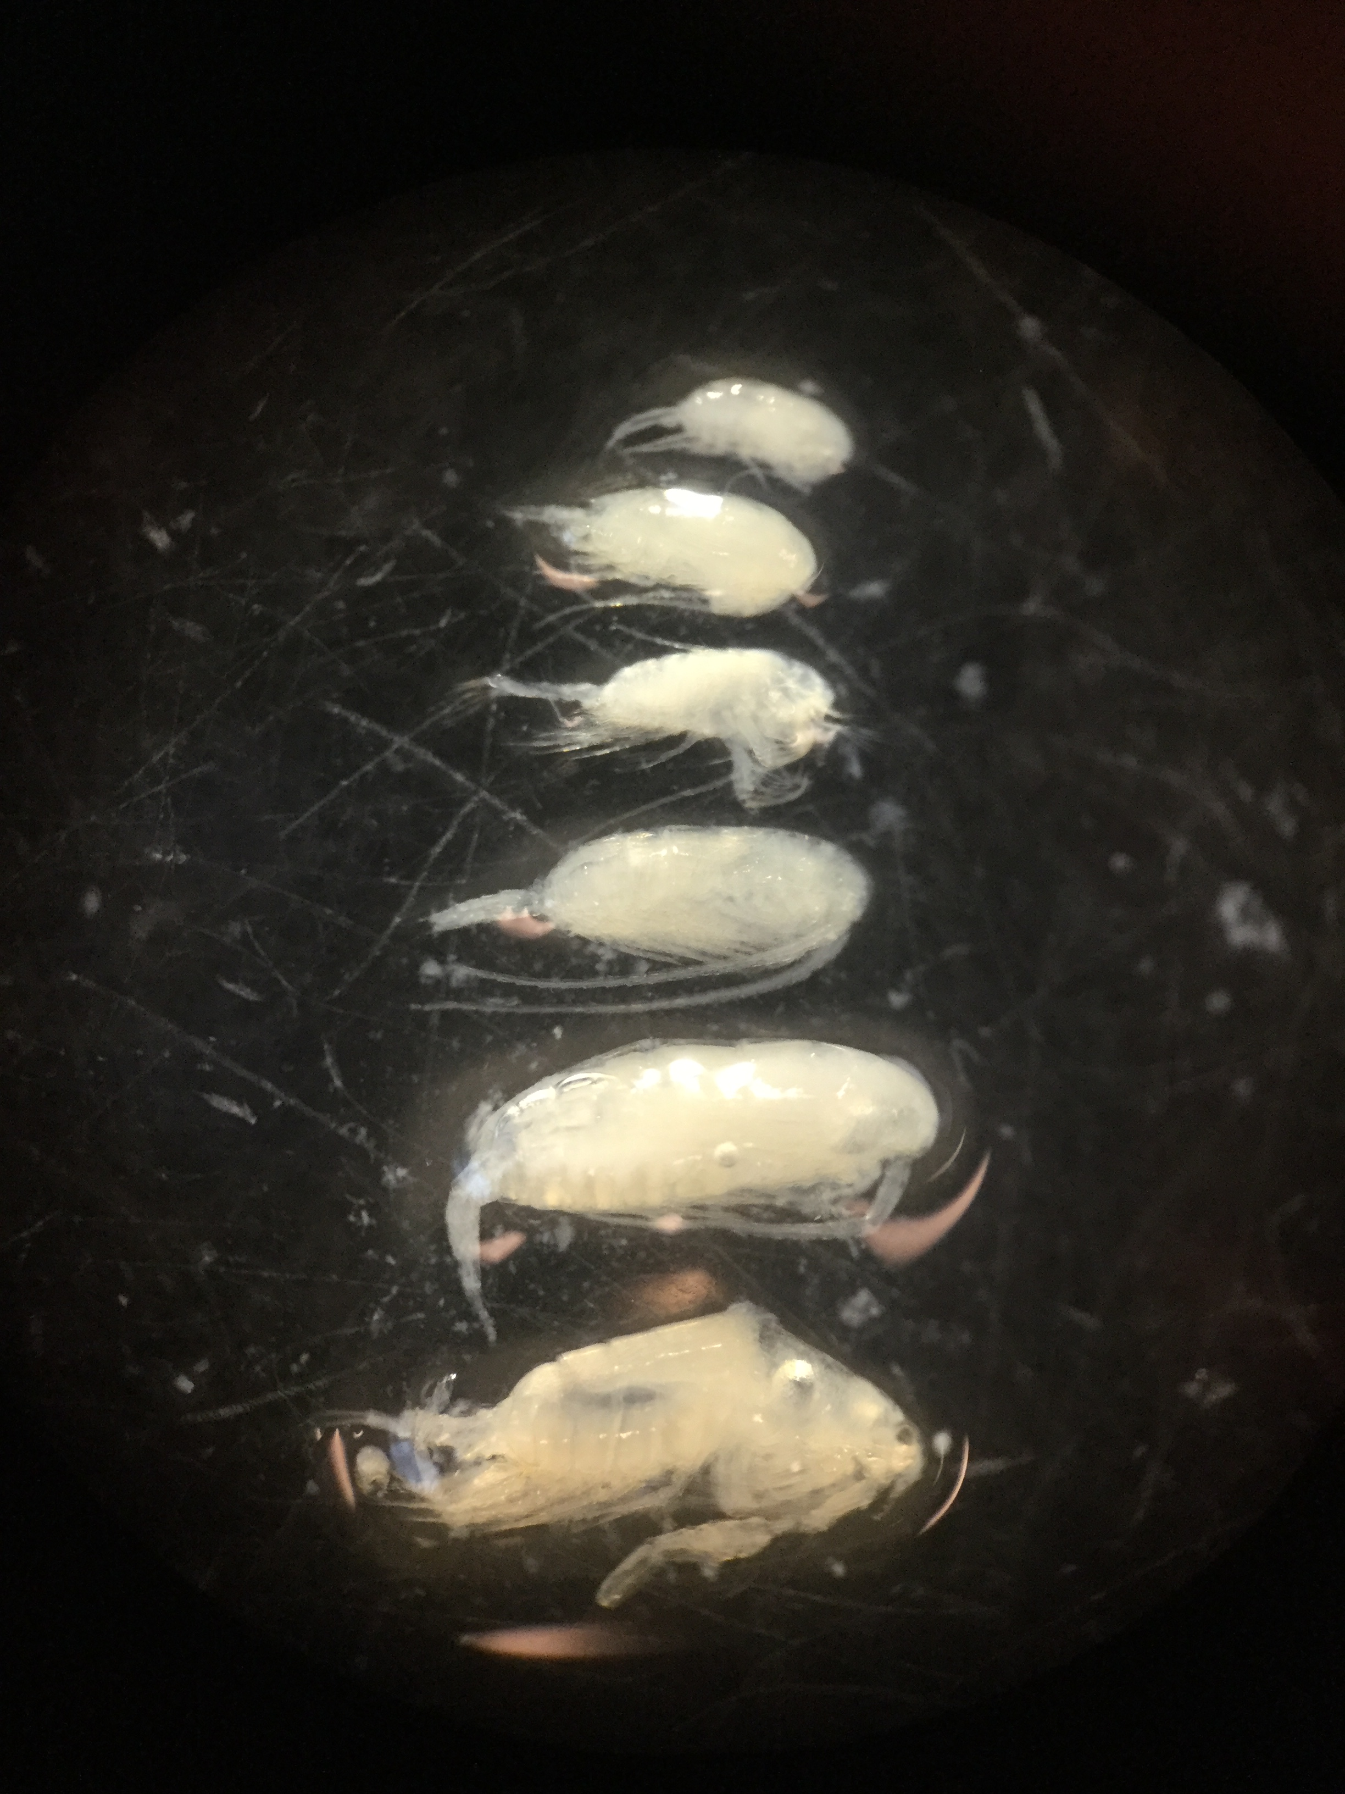
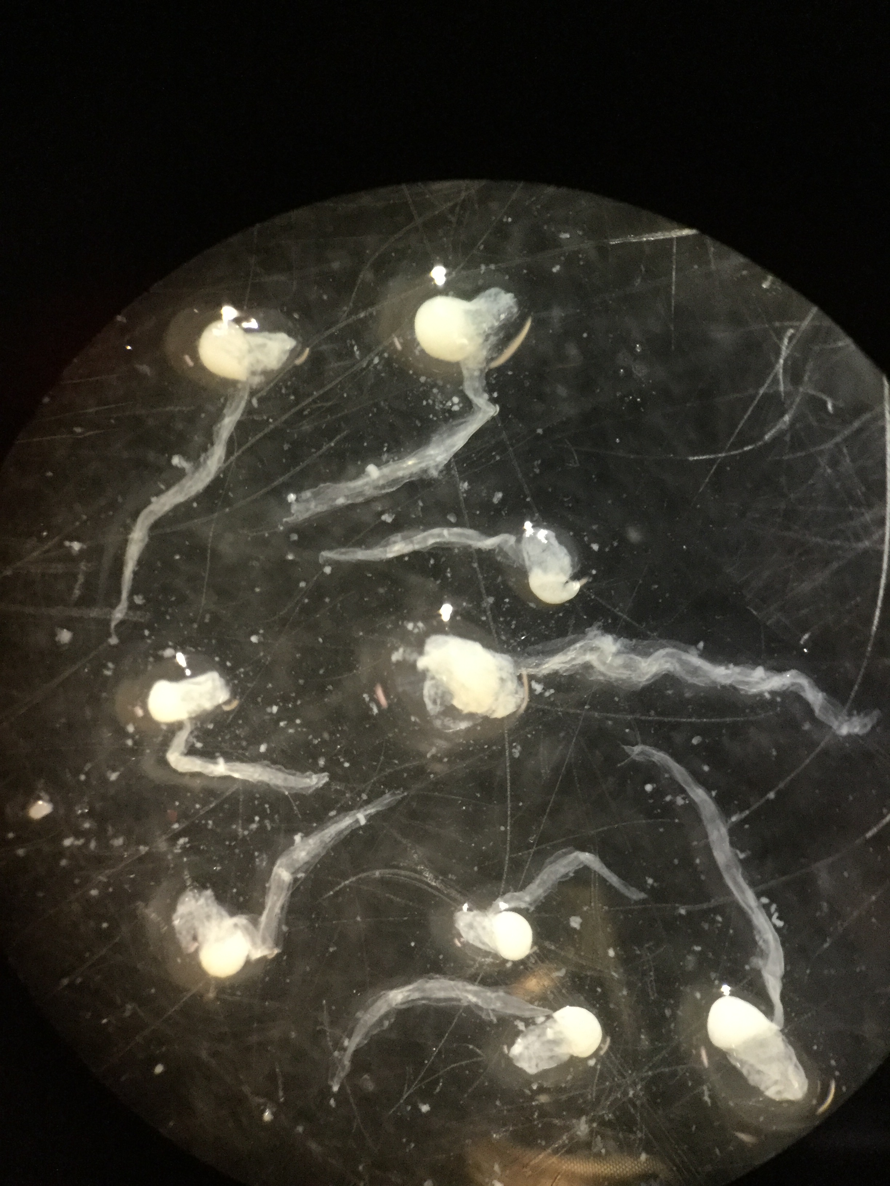
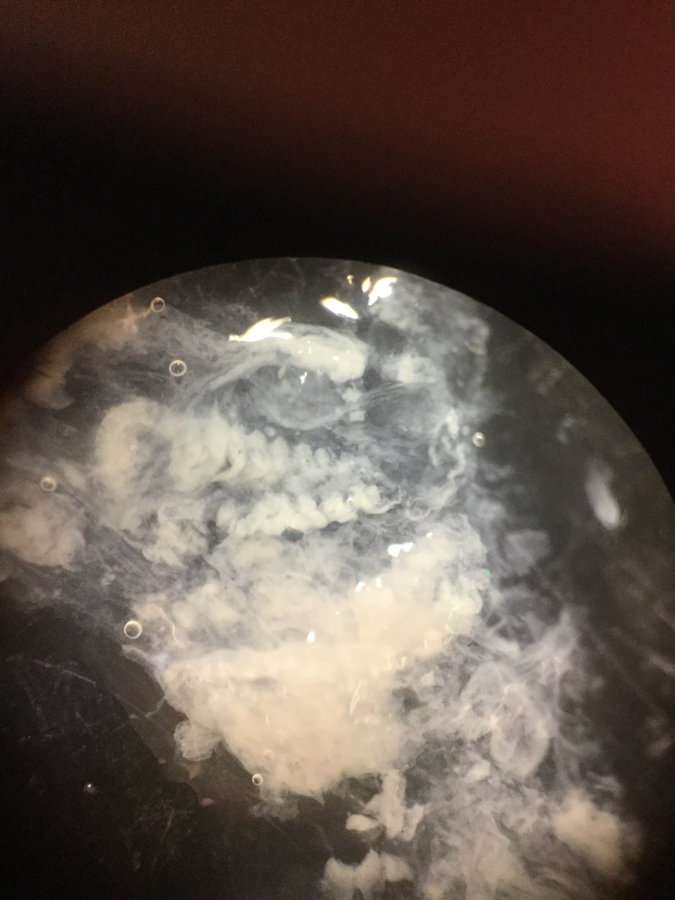
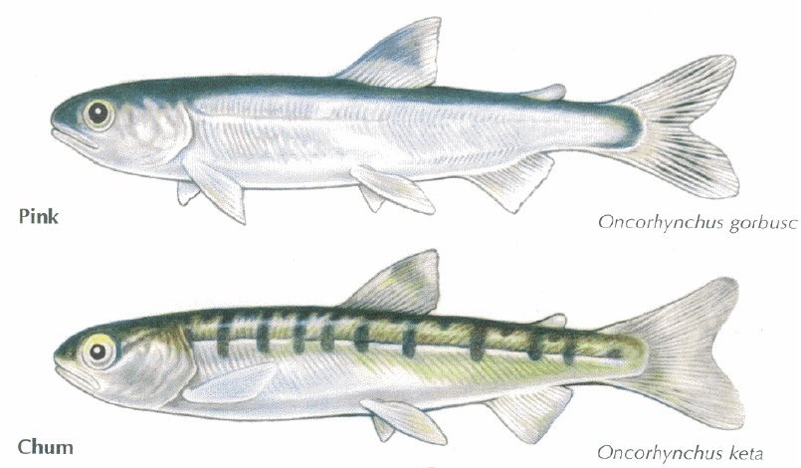

Slide 11
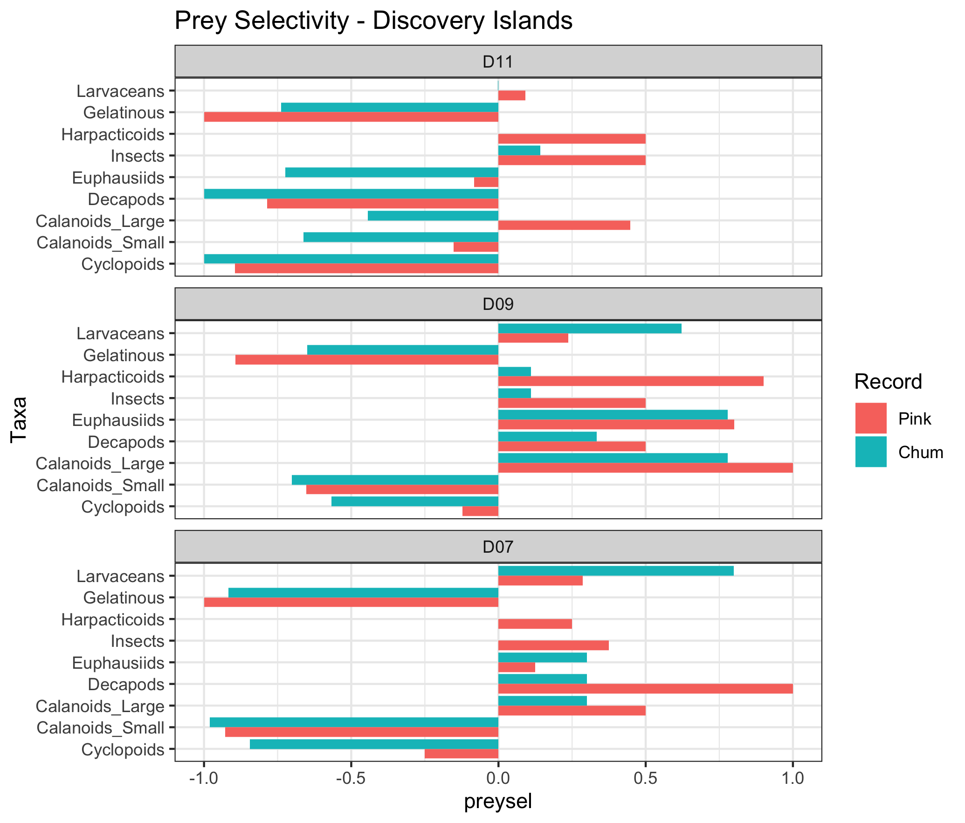

Slide 12
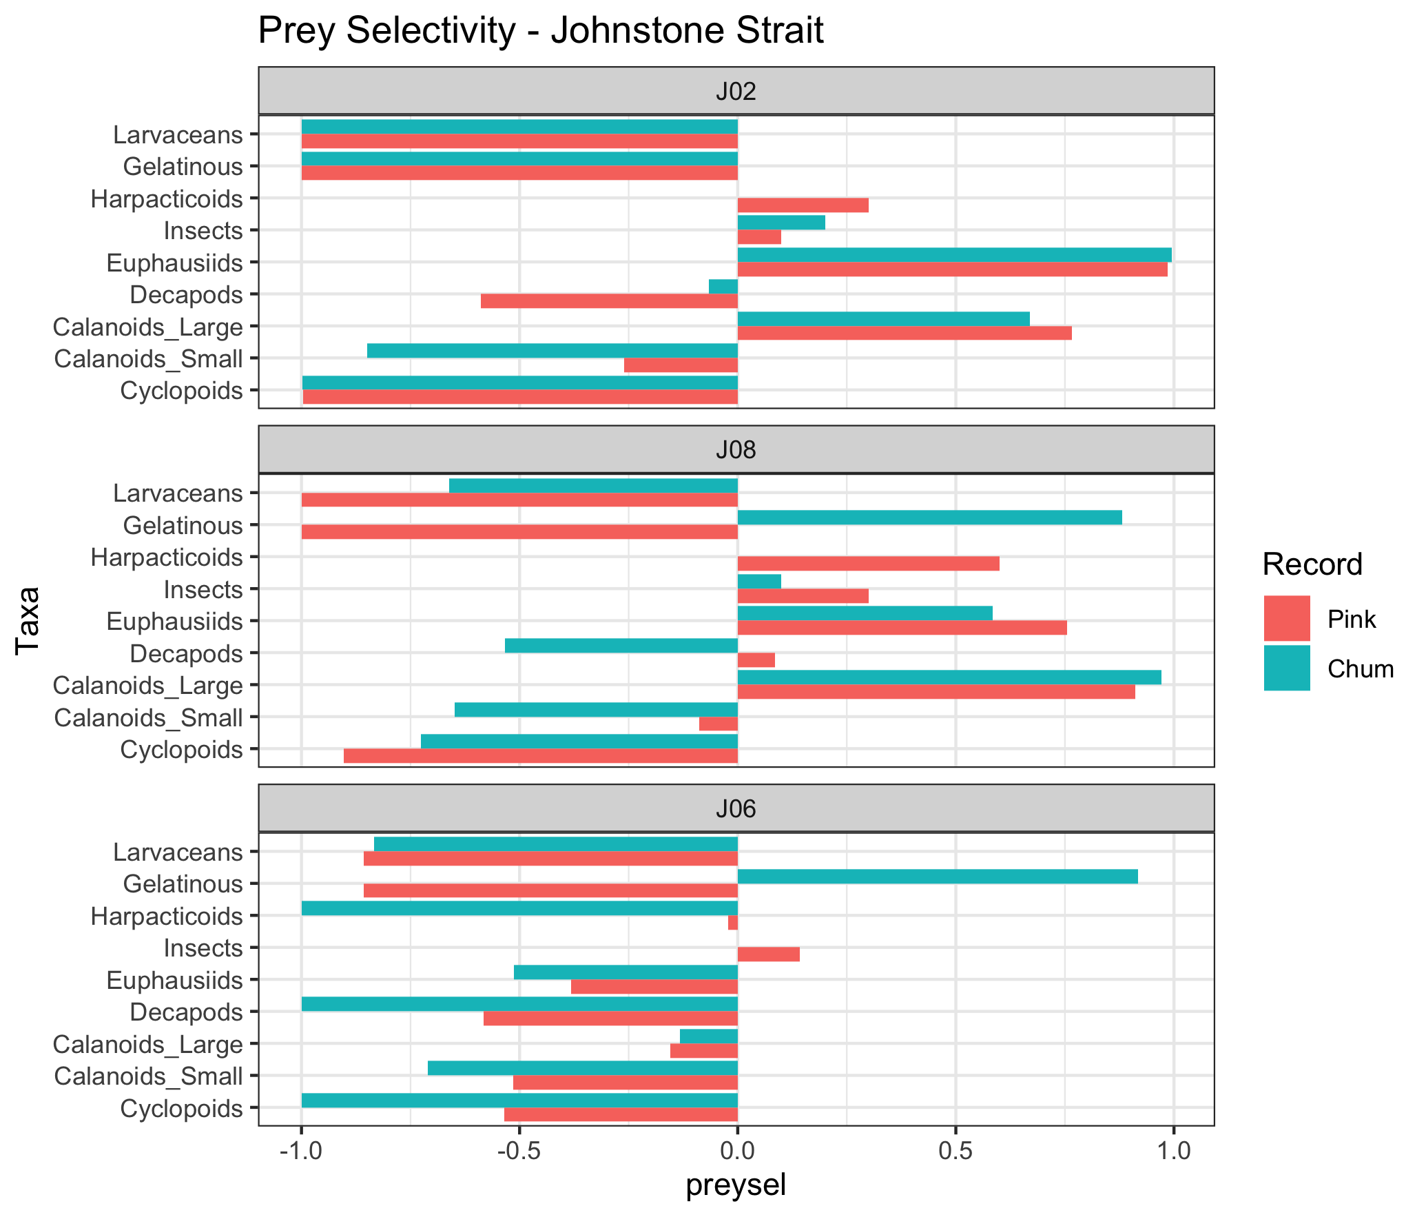

Slide 13
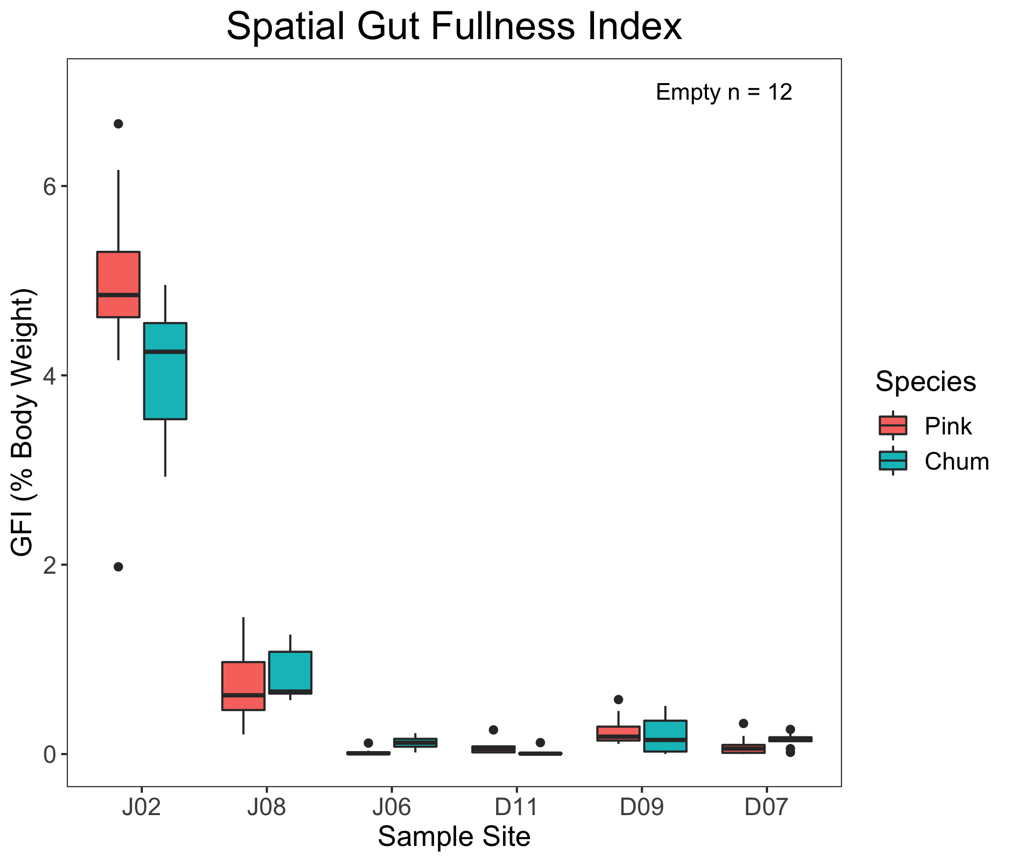

Slide 14
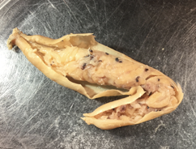
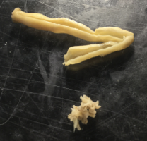

Slide 15
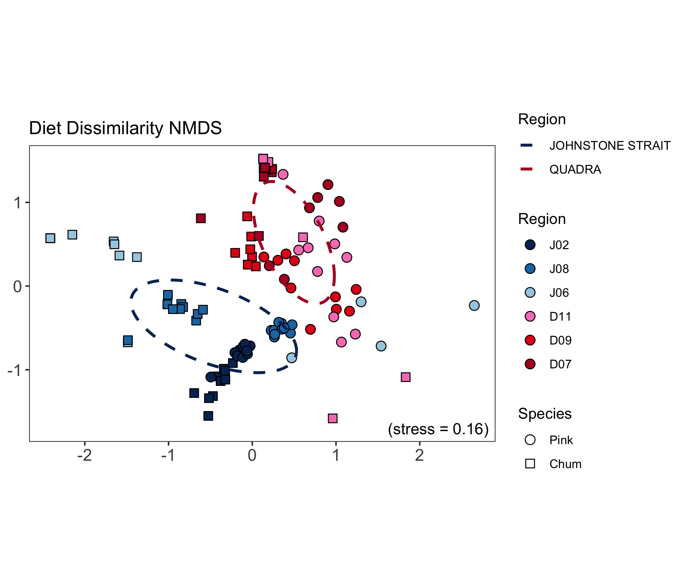
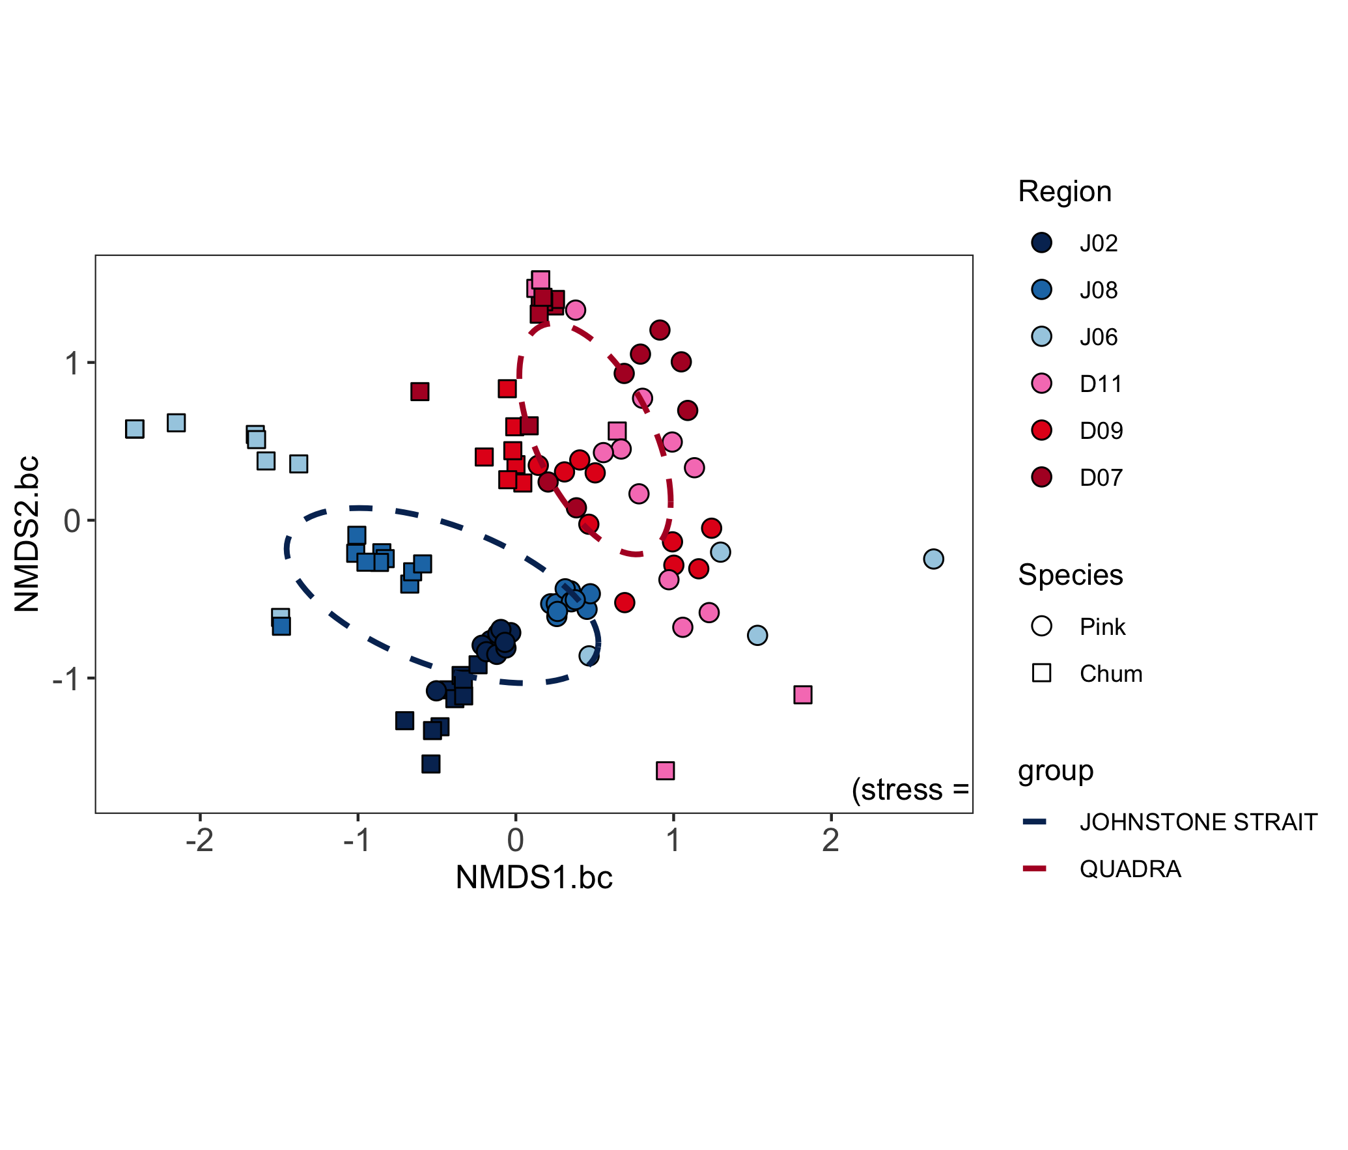
Spatial Chapter – Results

Slide 16
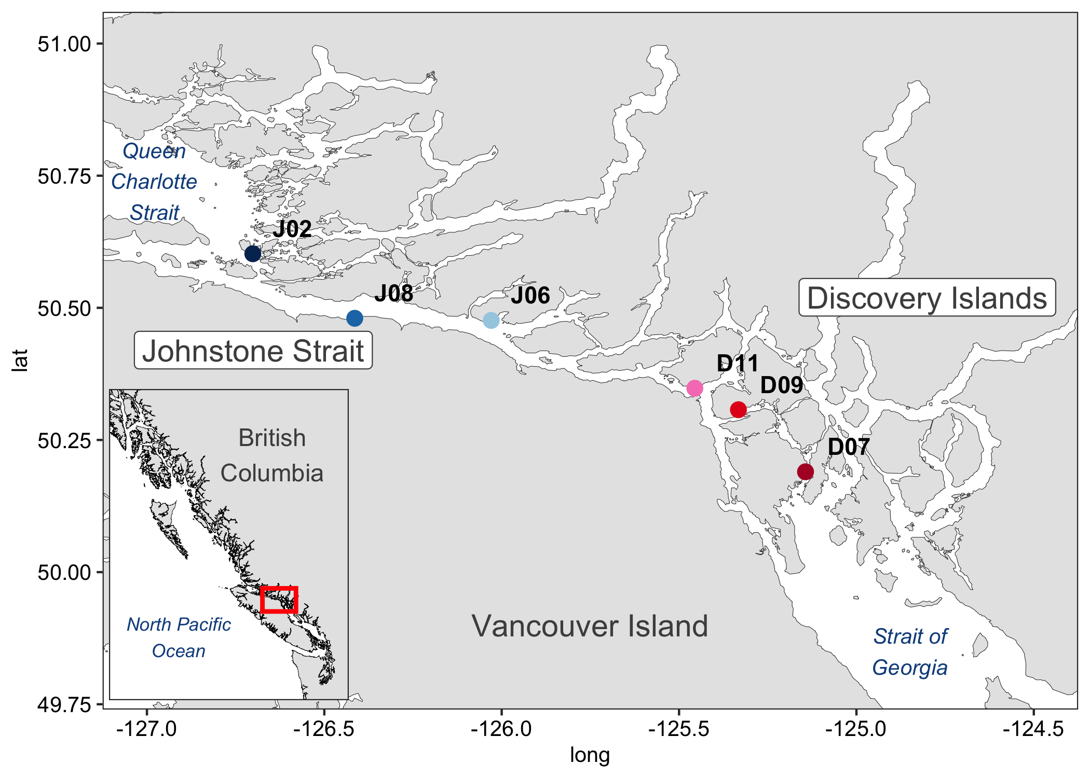
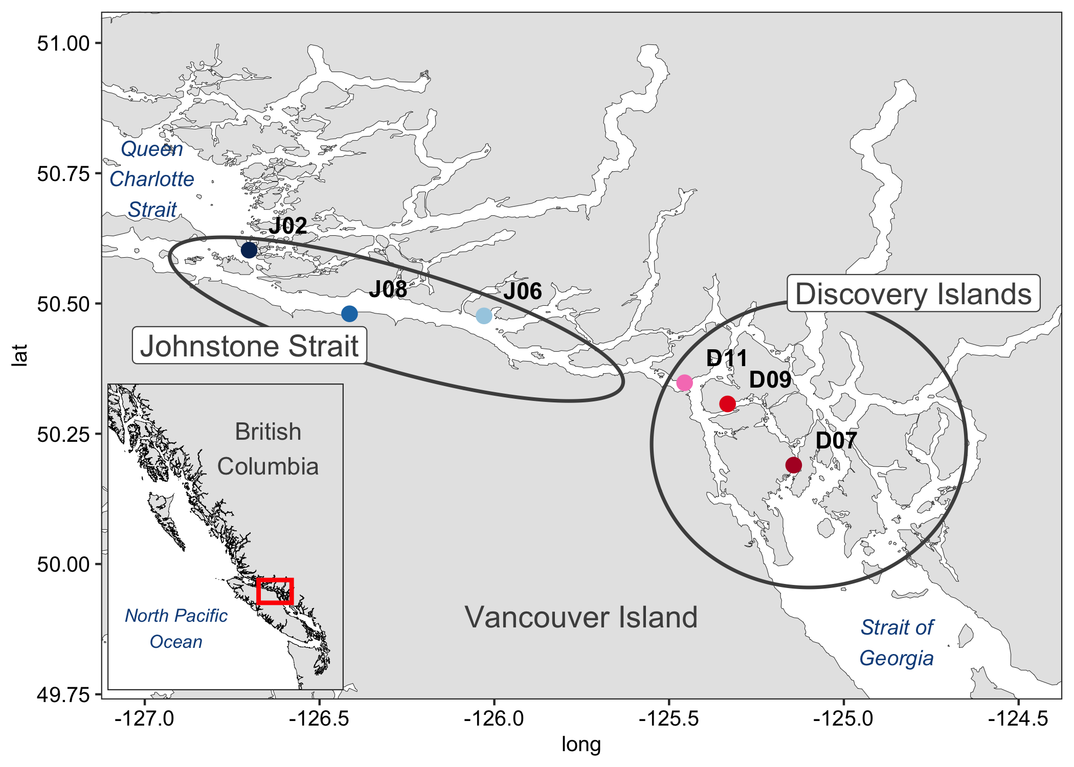
Spatial Chapter – Discussion
Discovery Islands: The gauntlet begins
Transition zone: Winners and losers
Johnstone Strait: Salmon prey shifts
Queen Charlotte Strait: Replenishment

Slide 17
Spatial Chapter – Discussion + Conclusion
Discovery Islands: The gauntlet begins
Transition zone: Winners and losers
Johnstone Strait: Salmon prey shifts
Queen Charlotte Strait: Replenishment
Migration route challenges
Adaptations through prey switching
Salmon species interactions

Slide 18
Spatial Chapter – Interactions & Adaptations
High foraging: similar diets Low foraging: different niches

Slide 19
Spatial Chapter – Results
Foraging habitats (look at prey composition for this? Other things??)

